Slide 1
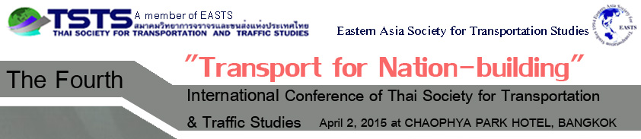

A Simple Investigation into the Stability of Lightweight Motorcycle
Chuthamat LAKSANAKIT
Pichai TANEERANANOON
and Kitti WICHETTAPONG
Presented by:
Chuthamat LAKSANAKIT
Ph.D student @ PSU
2 Apr 2015

Slide 2
Contents
Introduction
Methods
Data Analysis
Results
Conclusion

Slide 3
INTRODUCTION

Slide 4
Source : ASEAN Automotive Federation

Slide 5
Thailand’s Statistics

Slide 6
Claims
Involving Motorcycle Users
(RVP, 2013)
-28%

Slide 7
Source : Kasantikul 2001

Slide 8
Objectives
To investigate the stability of lightweight motorcycles of 3 different types of tyre on straight running

Slide 9
Methods

Slide 10
Rider: Professional riding instructor (8 yrs)
Experimental Apparatus: MC 125 cc, Smartphone, Wi-Fi camera, Laptop
Riding Test Course: Straight running test
Experimental Design: 3 tyre sets, 4 speeds, @ 10 rep
Process:
Methods

Slide 11
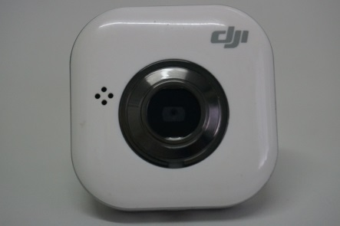
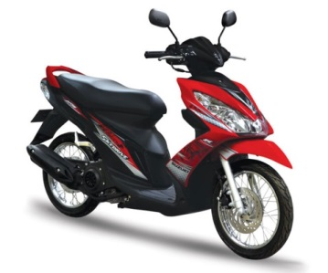
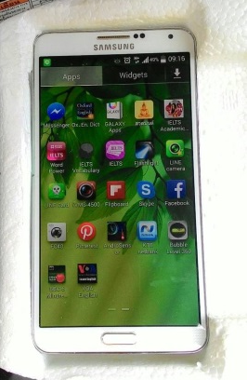
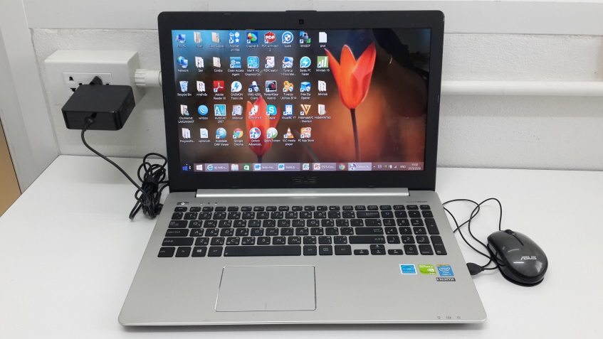
Experimental Apparatus:
Wi-Fi camera
Smart Phone
MC 125 cc
SUZUKI Sky Drive
Laptop

Slide 12

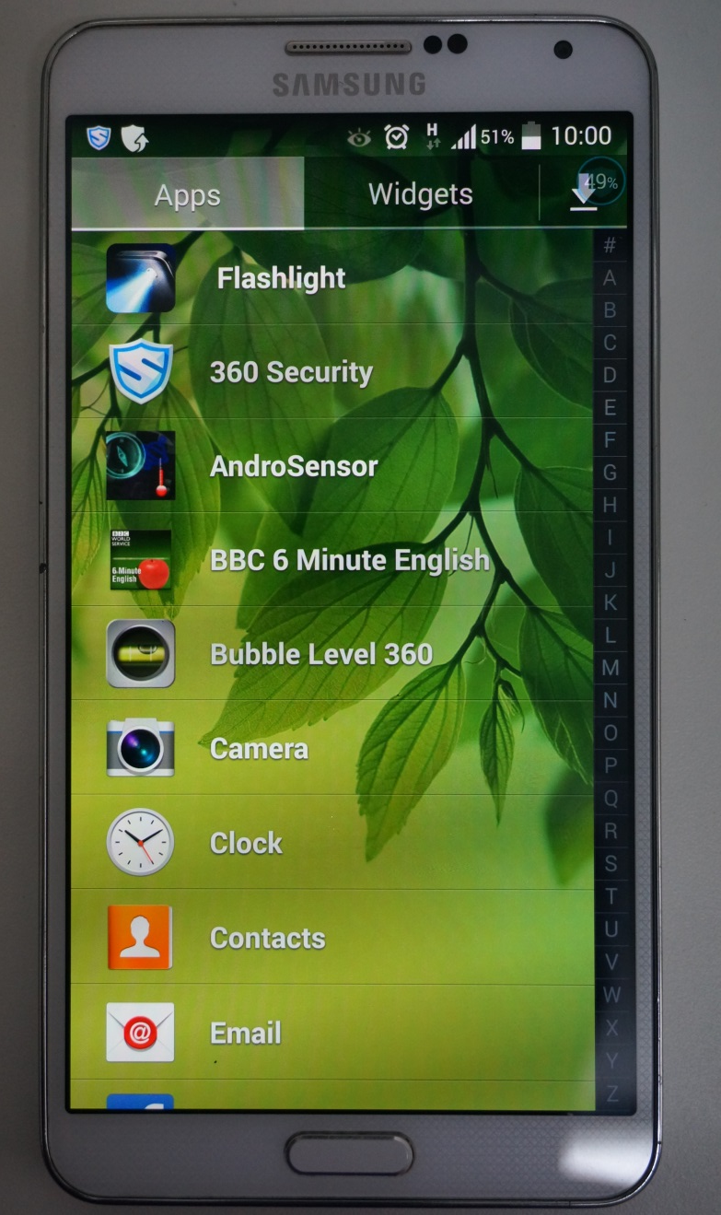

Experimental Apparatus:

Slide 13
Experimental Design
 | Front Wheel | Rear Wheel | Remark
Tyre set A | 70/80-14 M/C 34P | 80/90-14 M/C 40P | *Standard Configuration
Tyre set B | 90/90-14 M/C 46P | 90/90-14 M/C 46P
Tyre set C | 110/70-14 M/C 56P | 120/70-14 M/C 61P
Front
Rear
Tyre set
A

Slide 14
Experimental Design
Front
Rear
Tyre set
B
Front
Rear
Tyre set
C

Slide 15
Process:
Briefed on the path and procedure
Rider controlled the vehicle until constant the speed
Rider took the hands off the handlebar
Rider stop the vehicle when the end of the path or oscillation amplitude approached an instability state

Slide 16
Data analysis

Slide 17



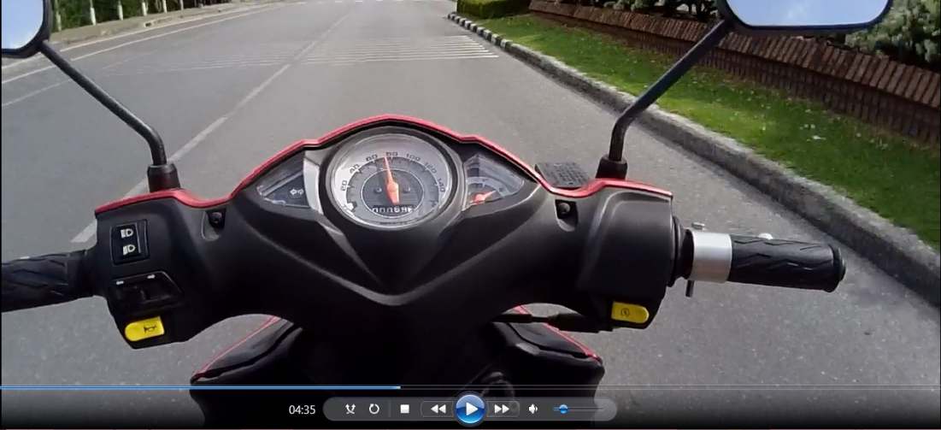

Slide 18
results

Slide 24
conclusions

Slide 25
No differences in motorcycle stability on straight motion with longitudinal speed lower than 60 km/h when the tyre width is in the 70 mm to 120 mm range

Slide 26
acknowledgement

Slide 27
This research was financially supported by the Prince of Songkla Graduate Studies Grant. The authors would like to thank THAI SUZUKI MOTOR Co.Ltd. (Thailand) for their generous support of 2 motorcycles for the study (SUZUKI Sky Drive). The authors are grateful to the professional riding instructor of the Disaster Prevention and Mitigation Center 12 Songkhla for his kind help in providing skillful riding for the tests.

Slide 28
references

Slide 33
Thank
you
for Your Attention
and Comments

